Slide 1
PLATFORM
Get Noticed in a noisy world
By Michael Hyatt
Derrick L. Black
Nov. 13, 2013
EDAD 5319-20
Book Study Presentation

Slide 2
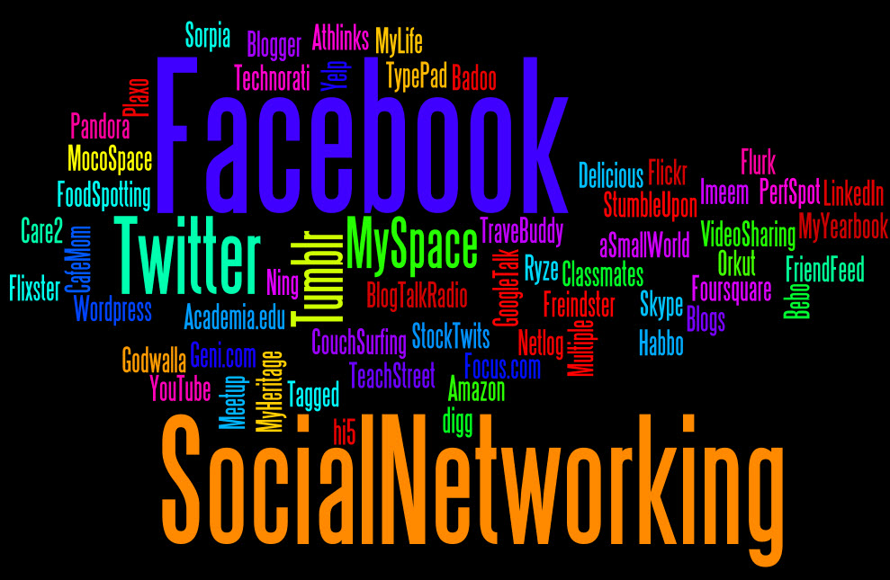
How often do you use social media tools?
Let’s take a quick survey…

Slide 3
PLATFORM at a Glance
Introduction: All the World’s a Stage
Part One: Start with Wow
Part Two: Prepare to Launch
Part Three: Build Your Home Base
Part Four: Expand Your Reach
Part Five: Engage Your Tribe

Slide 4
Introduction: All the World’s a Stage
William Shakespeare wrote, “All the world’s a stage.”
Stage has never been more crowded than now.
Learn how to stand out from the crowd.
Not through just a talk show, newspaper ad, commercial, or any other traditional marketing strategy…
…but by creating a platform built of people. Contacts. Connections. Followers.
Have to connect the who (people) with the (product).
A platform provides visibility, amplification, and connection.

Slide 5
Part 1: Start with Wow
Two critical parts of the success equation: a compelling product (the what) and a major platform ( the who).
Without the what, the who is pointless.
Marketing guru, David Ogilvy, once wrote, “Great marketing only makes a bad product fail faster.”
What elements create a wow experience?
Beware of the obstacles.
Don’t settle for less than great!
Give your product a memorable name.
Know your audience, consider your brand, and invest in the packaging of your product.

Slide 6
Part 1: Start with Wow
Insights learned from watching Steve Job’s 2007 keynote presentation from MacWorld and introduction of the iPhone:
Create products you would personally use.
Create products that solve problems in unexpected ways.
Create products that exceeds your customers’ expectation.

Slide 7
Part 2: Prepare to Launch
Accept personal Responsibility. No one knows your product better than you and is more passionate about it than you are.
Define your platform goals.
Create an elevator pitch.
Set up your branding tools.
Assemble your pit crew.
Secure endorsements.
Get a great head shot.
Develop an Online media kit.

Slide 8
Part 3: Build Your Home Base
A good social media strategy has three components:
A home base.
Embassies.
Outposts.

Slide 9
Part 3: Build Your Home Base
Focus Your Efforts Online – Don’t waste time, energy, and money on commercial mass media.
“Narrowcast” to targeted audience through use of Internet.
Get help if needed but be careful of self-proclaimed social media experts.
Start a Blog and select a service (WordPress.org, TypePad.com, o Blogger.com)
Don’t have someone write for you. Be your own writer…more authentic and personal.
Avoid common blogging mistakes.

Slide 10
Part 4: Expand Your Reach
Marketing is dead.
Tribe-building is the new marketing.
Generate more blog traffic.
Build your subscriber list.
Promote older post.
Give away stuff.
Embrace Twitter.
Devote thirty minutes a day.
Use Twitter to promote your product.

Slide 11
Part 5: Engage Your Tribe
Get more blog comments.
Keep the conversations civil.
Develop a comments policy.
Monitor your brand. (Google Alerts, Twitter search, engage in conversation, and solve the problem.)
Defend your brand.
Don’t feed the trolls.
Monetize your blog. (sell advertising, promote affiliates, and sell products)

Slide 12
Conclusion
Overcome fear…just take the first step!!!
The KEY is to START!!!

Slide 13
References
Carter, S. (2012, 05) “For and Against: Social Media at Work” Engineering and Technology Magazine.
Document URL
http://eandt.theiet.org/magazine/2012/05/debate.cfm
Hunter, R. (2013, 02, 04) “Why Companies Need to Protect Themselves Against the Risks of Social Media” eSocialMedia.
Document URL
http://www.esocialmedia.co.uk/2013/02/04/why-companies-need-to-protect-themselves-against-the-risks-of-social-media/
Hyatt, M. (2012) “Platform: Get Noticed in a Noisy World” Nashville, TN: Thomas Nelson.
Yohn, D.L. (2013, 02, 11) “A Case Against Social Media” QSR Magazines.
Document URL
http://www.qsrmagazine.com/denise-lee-yohn/case-against-social-media

Slide 14
Images Used
http://milongo89.blogspot.com/2012/09/pros-and-cons-of-social-networking.html
http://www.brandyoubrilliant.com/pros-and-cons-of-advertising-on-social-media/
http://www.laurenmacewen.com/2012/10/09/the-pros-and-cons-of-outsourcing-social-media-management/

